Slide 1

Future of Reinforcement Learning in Banking and Finance
Discussing the Effects of Reinforcement Learning in Banking & Finance, Some Notable Applications, Threats and the Future it Holds.

Slide 2
All about Reinforcement learning
What is Reinforcement Learning?
BASIC COMPONENTS OF RL
How RL works?
RL is a part of ML where an agent learns to behave in an environment by performing actions and seeing the results.
RL is all about taking an appropriate action to maximize the reward in a particular situation
There is no expected output in RL. Agent decides what action to take in order to maximize the reward
Finds the best possible behavior or path by learning from experimentation while interacting with an external environment
Exploitation and exploration
Agent: The RL algorithm that learns from trial and error.
Environment: The world through which the agent moves
Action : All the possible steps that agent can take
State: Current condition returned by the environment
Reward: An instant return from the environment to appraise the last action
Policy: Approach an agent takes to take next action based on current state
Value: Expected long tern return
Action-value : Similar to value, except it takes current action in account
Input: The input is an initial state from which the model will start
Output: There are many possible output as there are variety of solution to a particular problem
Training: The training is based upon the input (current state), the model will return a new state and the associated reward.
Based on Reward Maximization
The model keeps continues to learn.

Slide 3
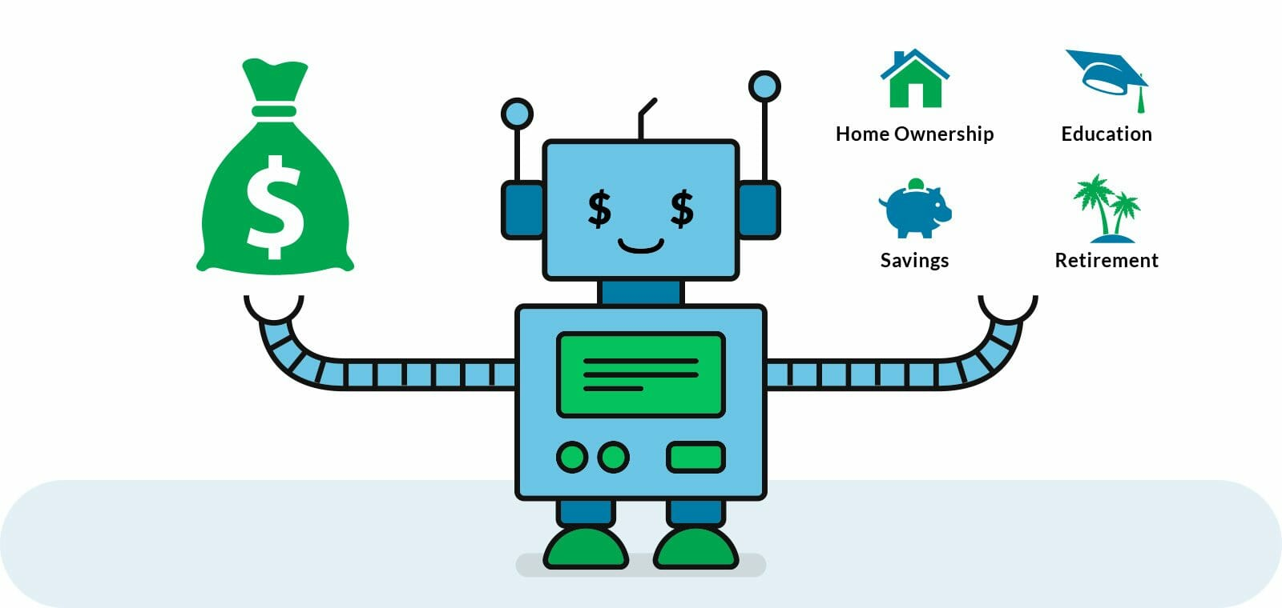


The Future of Reinforcement learning
Applications in Banking and Finance
Robo-advisors
Chatbots
Wealth Management
What?
Online software that can help to manage investments based on your personal data and investment goals
Also known as Digital Advise Market
Why?
Highly efficient portfolio management tool that creates better investment plans
Delivers optimization in customer delivery and space management
What?
Live chats with chatbots to give clients instant solution to problems.
Chatbots like the one “Kasisto” use, give real time update to monitor personal finances
Why?
User friendly chatbots to enhance customer relations.
Cut employment costs
What?
IBMs’ Armanta manage market, credit and liquidity risk.
Financial Crimes Insight Engine that detects and advice users of fraudulent transactions.
Why?
Identify the investment preferences of a client and provide personalized advice
Communicate the most relevant insights for a client at a preferred time and channel.

Slide 4
Other applications:
Search Engine: RL is used to provide platforms where brokers and traders can have access to information on both private and public companies such as SEC and global filings, earning call transcripts, and press releases. It also equips its users with the ability to research and discover trends in financial markets. Alpha-Sense is one of such examples.
Resource Management: RL aids in the design of intelligent algorithms used for allocating limited resources. RL automatically learns to allot and schedule resources effectively while also minimizing the average job slowdown.

Slide 5
Conclusion
By 2020, “Gartner” predicts a massive 84% of customer dealings with any enterprise will happen without another human interaction,
Reinforcement learning relies solely on data. Once data is tampered with, the model will be inaccurate and give false information, probably leading to a significant loss.
With practical solutions to data breaches and security threats, and more, the future is set to witness a significantly lower risk level in using AI backed processes.
Also, better predictability and decision-making process for banking and finance is set to benefit from Reinforcement Learning in the future massively.

Slide 6
THANK YOU
FOR
LISTENING!!

